Slide 1
RESUSCITATION FROM
HEMORRHAGIC SHOCK
by Wubayehu Amare ( BSC, MSC)

Slide 2
Out line
Define resuscitation
Pathophysiology of hemorrhagic shock
Trauma-Induced Coagulopathy (TIC)
damage control Hemostatic Resuscitation(DCHR)
Massive Transfusion Protocols
Damage Control Surgery
Anesthesia for DSC

Slide 3
Resuscitation from Hemorrhagic shock
Haemorrhage is the second leading cause of death after traumatic brain injury.
It is the most preventable cause of death in trauma cases.
Mortality Statistics:
  Approximately 44% of trauma-related deaths occur in-hospital.
  Haemorrhage accounts for:
    18% of deaths from blunt injuries.
    55% of deaths from penetrating injuries.

Slide 4
Cont…
Resuscitation:
  Defined as the restoration of normal physiology after injury. involves:
    Normal circulating blood volume
    Normal vascular tone
    Normal tissue perfusion
  Begins immediately after injury through the patient’s own compensatory mechanisms.
    Continues through various phases of care: Pre-hospital, ED, OR & ICU

Slide 5
Pathophysiology of hemorrhagic shock
Hemorrhage: Leads to a decrease in circulating blood volume.
  Compensatory Mechanisms: Activation of the sympathetic nervous system and release of catecholamines to maintain blood pressure.
Imbalance:
  Oxygen Delivery vs. Consumption: Inadequate oxygen supply to tissues leads to cellular hypoxia.

Slide 6
cont
Physiological Consequences:
  Hemodynamic Instability: Drop in cardiac output and blood pressure.
  Coagulopathy: Impaired clotting due to dilution of clotting factors and platelet dysfunction.
  Decreased Tissue Perfusion: Reduced blood flow to vital organs.
Cellular Effects:
  Ischemia: Cells switch to anaerobic metabolism, leading to lactic acidosis.
  Fluid Shift: Ischemic cells absorb interstitial fluid, exacerbating intravascular fluid depletion.

Slide 7
Initial response to hemorrhage
Macro-Circulatory Level:
  The response is mediated by the neuroendocrine system.
  Mechanisms:
  Decreased Arterial Blood Pressure:
    Triggers vasoconstriction to maintain blood flow.
    Promotes release of catecholamines (e.g., epinephrine, norepinephrine) to preserve perfusion to vital organs (heart, kidneys, brain).

Slide 8
Cont..
Regional Responses:
  Constriction of Non-Essential Vascular Beds: Redirection of blood flow to critical areas.
Hormonal and Inflammatory Mediators:
  Release of hormones due to pain, hemorrhage, and cortical perception of injury, including:
      (Renin, Angiotensin, Vasopressin, Antidiuretic Hormone (ADH), Growth Hormone, Glucagon, Cortisol, Epinephrine, Norepinephrine)

Slide 9
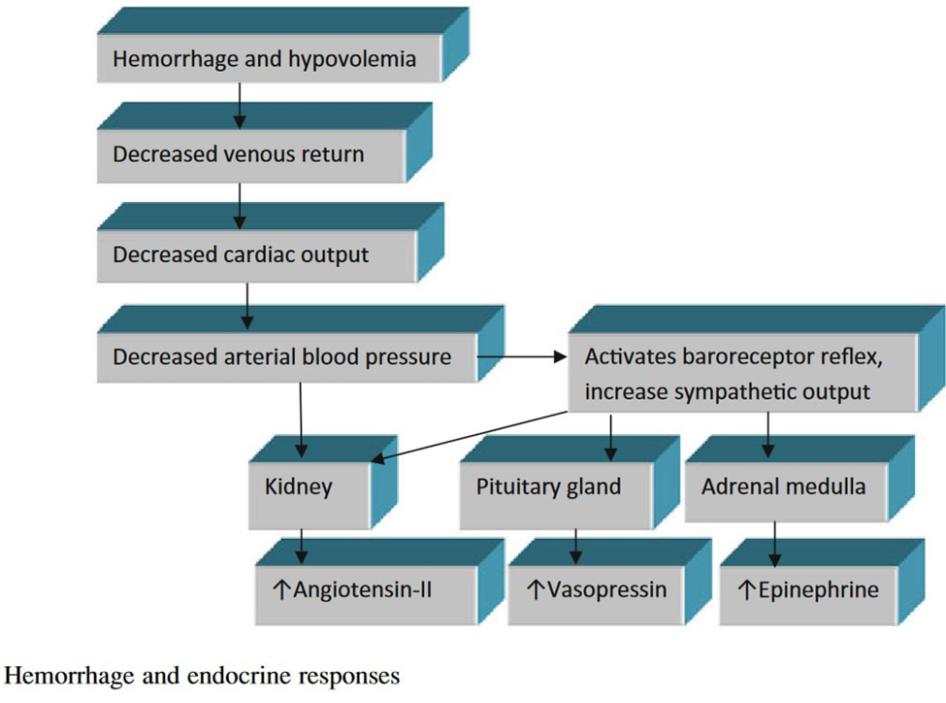

Slide 10
Cont....
At microcirculatory level,
  Cellular Reaction to Ischemia; Ischemic tissue cells suck up interstitial fluid, further depleting intravascular volume.
Consequences of Fluid Uptake:
  Cellular Volume Expansion: Leads to cellular edema, which can obstruct nearby capillaries.
  "No-Reflow" Phenomenon ; Edema may create areas of “no-reflow,” preventing adequate blood flow to those tissues.
This condition significantly reduces the likelihood of ischemic reversal, even if macro-perfusion is restored.

Slide 11
Cont…
At the cellular level
Oxygen Delivery Insufficiency:
  Hemorrhagic shock occurs when oxygen delivery fails to meet the demands for aerobic metabolism.
Shift to Anaerobic Metabolism:
  Cells transition to anaerobic metabolism.
  Accumulation of: Lactic Acid, Inorganic Phosphates, Oxygen Radicals

Slide 12
cont
Consequences of Metabolic Failure:
  ATP Depletion: Leads to loss of cellular homeostasis.
  Cell Death Mechanisms: Necrosis (membrane rupture), Apoptosis, or Necroptosis
Toxic Load Accumulation:
  Ischemic cells produce lactate and free radicals, which accumulate in the interstitial space when circulation and perfusion are diminished.

Slide 13
Cont..
  Upon reestablishment of blood flow, these toxic substances enter the intravascular circulation, potentially causing direct cellular damage.
Release of Inflammatory Factors:
  Ischemic cells also produce and release various inflammatory mediators, including:
      Prostacyclin, Thromboxane, Prostaglandins, Leukotrienes, Endothelin, Complement, Interleukins and Tumor Necrosis Factor (TNF)

Slide 14
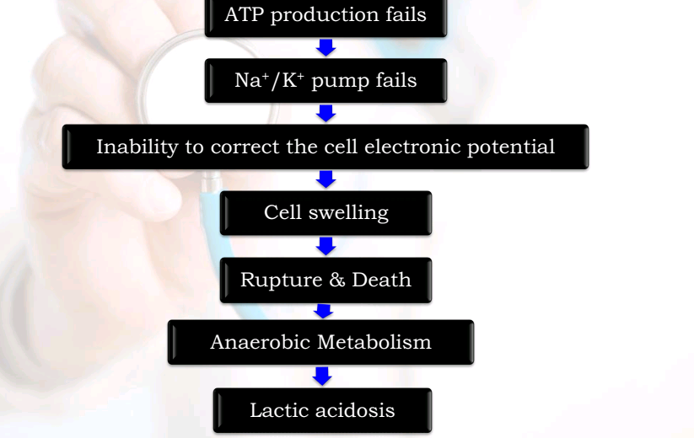

Slide 15
Cont…
At the tissue level
Hypoperfusion:
  Resulting from hypovolemia and vasoconstriction, leading to inadequate blood flow to vital organs.
End-Organ Damage:
  Organs affected include: Kidneys, Liver, Intestines, Skeletal Muscle
Risk of multi-organ failure in survivors due to prolonged hypoperfusion.

Slide 16
Cont..
Extreme Hemorrhage:
  In cases of exsanguination, the absence of pulse results in severe hypoperfusion of:
    Brain: Leads to cerebral anoxia.
    Myocardium: Can result in fatal arrhythmias within minutes.
Vascular Endothelial Changes:
  Hemorrhage induces profound alterations in the vascular endothelium, affecting its integrity and function throughout the body.

Slide 17
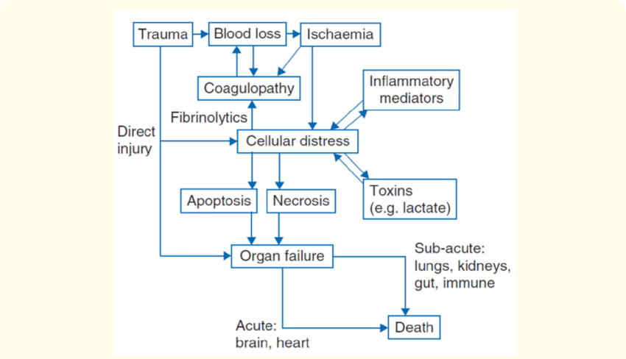
Figure 1: The pathophysiology of hemorrhagic shock.

Slide 18
Stages of Hemorrhagic Shock
1. Compensated Stage
Characteristics:
  Preserved Blood Pressure: Maintained through increased sympathetic nervous system (SNS) activity.
  Normal Blood Pressure: Does not exclude the presence of early shock.
Compensatory Mechanisms:
  The body initiates responses to control decreased perfusion, including:↑HR, Vasoconstriction, Redistribution of Blood Flow to vital organs.
  .

Slide 19
Cont..
Fluid Loss:
  Typically involves a 15-25% loss of intravascular volume.
Outcome:
  In this stage, normal circulatory compensatory mechanisms may lead to full recovery without external intervention.

Slide 20
Cont…
2. Decompensated Stage
Characteristics:
  Gradual Failure of compensatory mechanisms.
  Hypotension: Blood pressure begins to drop.
  Systemic Hypoperfusion: Inadequate blood flow to tissues leads to dysfunction.
Consequences:
  Sequential End-Organ Dysfunction: Affects vital organs, increasing risk of multiorgan failure.

Slide 21
Cont…
3. Irreversible Stage
Characteristics:
  Irreversible Hemodynamic Collapse: Blood pressure cannot be maintained.
  End-Organ Failure: Persistent damage to multiple organs, leading to critical failure.
Outcome: High mortality risk; recovery is unlikely without immediate and aggressive intervention.

Slide 22
Signs and physical findings
Adjunctive physical findings
Pallor on the skin
Cold sweating, perspirations
Decreased urine output (below 0.5 mL/kg/h in adults)
Angor animi/sense of impending doom
Vital signs
Tachycardia/Brady/ asystole
Tachypnea/dyspnea
Confusion and/or altered mental status
Hypotension > 30 min duration
Narrowed pulse pressure

Slide 23
Trauma-induced coagulopathy
Definition:
  A coagulopathy that occurs as a direct result of severe trauma, characterized by a disruption of the normal hemostatic processes.
Causes: Tissue injury, shock, and systemic inflammatory response.
Consequences: Impaired clot formation, increased bleeding risk, and poor patient outcomes.
Clinical Significance:
  Early identification and intervention are crucial for improving survival rates in trauma patients.

Slide 24
Pathophysiology:
  Coagulation Activation:
    Release of pro-coagulant factors
    Hyper-activation of the coagulation cascade
  Hyper-fibrinolysis:
    Increased breakdown of fibrin
    Impaired clot stabilization
  Consumption Coagulopathy:
    Depletion of clotting factors and platelets
    Leads to an imbalance in hemostasis
Early detection and treatment are essential for improving patient outcomes.

Slide 25
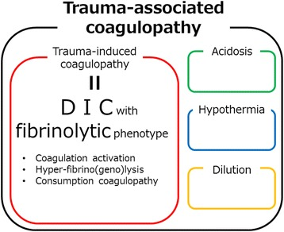

Slide 26
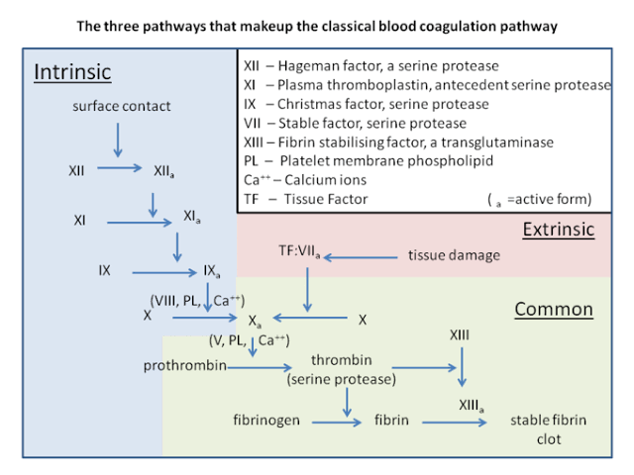

Slide 27
Cont..
Role of Global Tissue Hypo-perfusion in Trauma-Induced Coagulopathy (TIC)
  Global Tissue Hypoperfusion: Major factor in the development of TIC.
    Leads to altered hemostatic balance.
  Endothelial Response:
    Release of Thrombomodulin (TM) and Activated Protein C (APC).
    Thrombomodulin binds thrombin, preventing fibrinogen cleavage to fibrin.
    The Thrombin–Thrombomodulin Complex activates APC.

Slide 28
Cont..
Effects of Activated Protein C:
  Inhibits the extrinsic coagulation pathway (cofactors V and VIII).
  Suppresses activity of the prothrombin complex (Factor Va-Factor Xa).
Hyperfibrinolysis: Observed in severely injured patients.
    Mechanism poorly understood; may involve:
      APC formation due to hypo-perfusion.
      Consumption of Plasminogen Activator Inhibitor (PAI).
Clinical Implications:
Understanding these mechanisms is crucial for managing TIC in trauma patients.

Slide 29
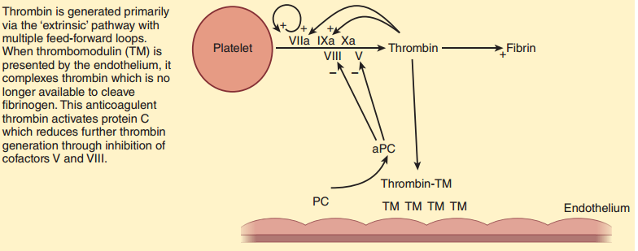
Fig. Mechanism of trauma-induced coagulopathy. During periods of tissue hypo perfusion, thrombomodulin (TM) released by the endothelium complexes with thrombin. The thrombin–TM complexes prevent cleavage of fibrinogen to fibrin and also activate protein C (PC), reducing further thrombin generation through cofactors V and VIII.

Slide 30
The main pathophysiological mechanisms involved in acute traumatic coagulopathy and transfusion strategy.

Slide 31
Damage Control Hemostatic Resuscitation
Early Prediction of Severe Hemorrhage:
  Certain patients are likely to require massive transfusion.
  Class III and IV Hemorrhagic Shock: Most likely coagulopathic upon presentation, despite normal initial lab results.
Shift in Resuscitation Strategy:
  Movement from crystalloid and colloid solutions to “Hemostatic Resuscitation.”
  Rapid loss of red blood cells and clotting factors necessitates immediate intervention without waiting for lab results.

Slide 32
Cont..
Damage Control Resuscitation (DCR):
  Components:
    Balanced and hemostatic resuscitation.
    Prevention of acidosis, hypothermia, and hypocalcemia.
  Monitoring:
    Laboratory values reassessed every 30–60 minutes to guide ongoing resuscitation efforts

Slide 33
GENERAL APPROACH TO RESUSCITATION
Goal of Early Resuscitation:
  The primary aim is to stabilize circulation while addressing hemostasis and performing necessary diagnostics.
Fluid Administration:
  This is the foundation of resuscitation. In cases of hemorrhagic shock, restoring intravascular volume is essential.

Slide 34
Cont…
Volume Loss Mechanisms:
  Hemorrhage: Direct loss of blood volume.
  Ischemic Cell Uptake: Cells in a state of ischemia can absorb fluid, further reducing intravascular volume.
  Extravasation: Fluid can leak into interstitial spaces due to increased permeability from trauma.
Effects of IV Fluids:
  Administering intravenous fluids effectively increases CO and ABP in hypovolemic patients, which is crucial for restoring adequate perfusion to vital organs.

Slide 35
Cont..
Goals of resuscitation include:
  Maintaining adequate perfusion pressure to the brain and other vital organs
  Avoiding irreversible shock
  Preventing clot disruption and worsening hemorrhage
  Restoring circulating volume
  Restoring the microcirculation
  Modulation of the immune and inflammatory response
  Restoring end-organ integrity and homeostasis

Slide 36
Fluid resuscitation
Fluid resuscitation is the first therapeutic intervention in traumatic hemorrhagic shock.
There is no proof in the literature that supports the superiority of one type of fluid over another type of fluid in trauma patients.
Colloids vs. Crystalloids:
  Colloids:
    Induce rapid and sustained plasma expansion due to higher oncotic pressure.
    Can quickly achieve circulatory goals.

Slide 37
Cont..
Crystalloids:
  Generally cheaper and widely used.
  No demonstrated survival benefit compared to colloids.
Potential Complications of Crystalloids:
  Tissue Edema: Large volumes can lead to fluid accumulation in tissues.
  Abdominal Compartment Syndrome: Increased risk due to fluid overload.
  Hyper-chloremic Metabolic Acidosis: Can occur with excessive saline infusion.

Slide 38
Fluid / Solution type | Characteristics | Advantage | Disadvantage
Albumin %4 | Osmolarity = 250 Na = 148 mEq/L | Safe, recipientfriendly | May cause hypoosmolar state, expensive
Plasma | Glucose 535 mg/dl, sodium 172 mEq/L, chloride 73 mEq/L, potassium 3.5 mEq/L, bicarbonate15 mEq/L, protein 5.5 g/dl (60% albumin) | Can be stored safely for longer than RBCs, standard cure for exsanguination-associated coagulopathy | Disease transmission risks, hypochloremia, hypernatremia, hyperglycemia
Hydroxyethyl starch (HES) 6% (130/0.4) | Osmolarity = 308 Na = 154 mEq/L Cl = 154 mEq/L pH = 3.5 - 7.0 | Easier to use when compared to blood products | May cause electrolyte abnormalities; hypernatremia, coagulation problems, hypocalcemia, hypokalemia

Slide 39
Normal saline | Osmolarity = 308 Na = 154 mEq/L Cl = 154 mEq/L | Not allergic, safe, cheap; alternative for Lactated Ringer’s | May cause electrolyte abnormalities; hypernatremia, hyperchloremic acidosis. Does not provide free water or calories.
Lactated Ringer’s | Osmolarity = 280 Na = 131 mEq/L K = 4 mEq/L Ca = 2.0 mEq/L Cl = 110 mEq/L Lactate = 28 mEq/L | Not allergic, safe, stable in storage, cheap; fluid choice for initial Resuscitation. More closely resembles the electrolyte composition of normal blood serum. | May cause electrolyte abnormalities; hypochloremia. Does not provide calories
table 1:- Different types of fluids and their characteristics in their clinical uses.
Notes:
Albumin can be used in patients with severe sepsis instead of other fluid types.
• Victims with traumatic brain injury must be treated with isotonic crystalloids.
• Hydroxyethyl starch is not indicated in patients with sepsis or those at risk for acute kidney injury.
• Semisynthetic colloids is not recommended, for safety issues.
• Fluids are intravenous drugs, thus caution should be exercised in usage. The type of the fluid, dose, indications, drawbacks,
toxicity, availability and prices should be taken into account before use.
• When possible, replace only the fluid lost in proper volumes.
Table 3: Fluid resuscitation principles in

Slide 40
Vasoactive agents
Role of Vasopressors:
  Vasopressor agents may be necessary to maintain life and tissue perfusion in cases of persistent hypotension.
  This is important even while fluid resuscitation is underway and before full correction of hypovolemia.
Norepinephrine (NE):
  Commonly used to restore arterial pressure in both septic and hemorrhagic shock.
  Recommended as the agent of choice for managing septic shock.

Slide 41
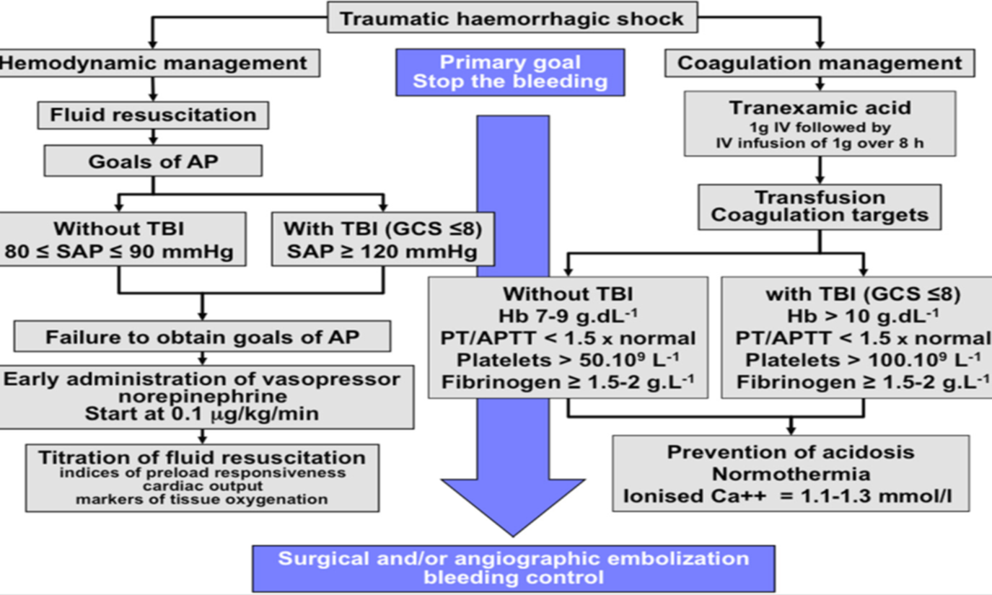

Slide 42
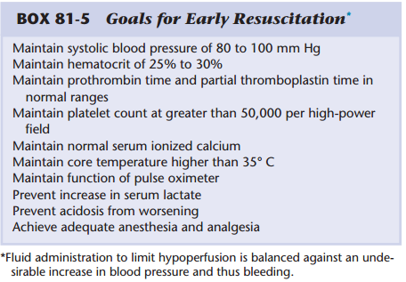
Damage control Hemostatic Resuscitation
Resuscitation of trauma patients should be considered in the following two phases:
I. Early: While active bleeding is still ongoing
II. Late: Once all hemorrhage has been controlled

Slide 43


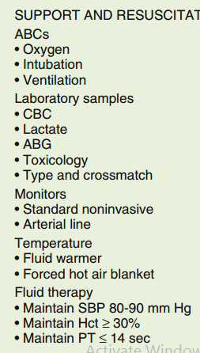
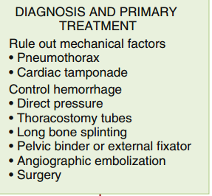
Fig. Algorithm for management of early hemorrhagic shock. ABCs, Airway, breathing, circulation; ABG, arterial blood gas; CBC, complete blood count; Hct, hematocrit; PT, prothrombin time; SBP, systolic blood pressure
NO
Yes
Late resuscitation

Slide 44
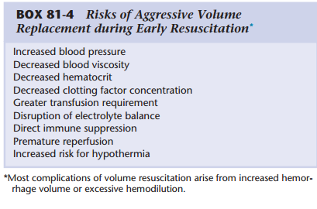
Risk of aggressive volume resuscitation

Slide 45
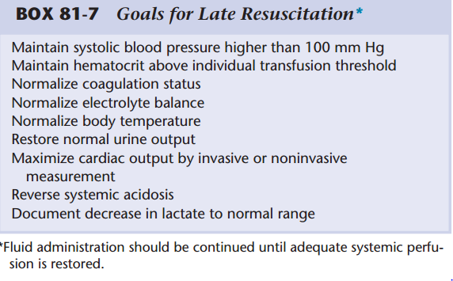
Goal of late Resuscitations

Slide 46
cont…
Trauma-induced coagulopathy is associated with increased mortality.
Transfusion Strategy: damage control resuscitation
  Administering blood products in equal ratios early in resuscitation is critical for correcting coagulopathy.
  The recommended transfusion ratio is 1:1:1 (red blood cells : fresh frozen plasma : platelets).
  This balanced approach enhances hemostatic function and improves patient outcomes.
  The use of crystalloid fluids in early trauma resuscitation has significantly decreased due to the focus on early blood product administration.

Slide 47
Blood Products
RBCs are a mainstay of resuscitation in the setting of hemorrhage, as they maintain oxygen delivery and avoid tissue ischemia.
The administration of RBC is considered indispensable when the hemoglobin level is <7 g/dL
Plasma products contain all plasma proteins and clotting factors.
  Fresh frozen plasma (FFP) is the most commonly employed plasma derivative.
    It is typically frozen within 8 hours of collection to preserve the activity of Factors V and VIII.
    One unit of FFP typically contains 250 to 400 mg of fibrinogen

Slide 48
Cont…
    FFP is now increasingly utilized in trauma care as part of plasma-rich resuscitation strategies
The early administration of red blood cells (RBC) and fresh frozen plasma (FFP) is a priority to maintain arterial oxygen delivery and restore an effective coagulation.
The administration of FFP should be associated as soon as possible with RBC transfusion to compensate for the deficit in coagulation factors.
The initial recommended dose is 10 to 15 ml/kg

Slide 49
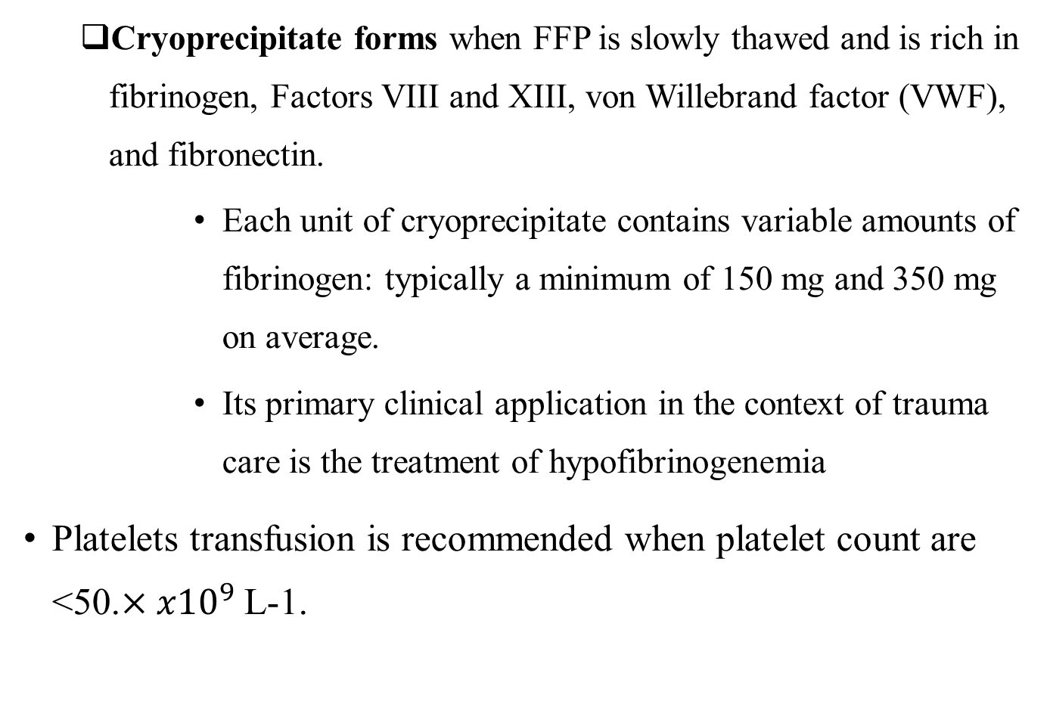
Cont..
  Cryoprecipitate forms when FFP is slowly thawed and is rich in fibrinogen, Factors VIII and XIII, von Willebrand factor (VWF), and fibronectin.
      Each unit of cryoprecipitate contains variable amounts of fibrinogen: typically a minimum of 150 mg and 350 mg on average.
      Its primary clinical application in the context of trauma care is the treatment of hypofibrinogenemia
Platelets transfusion is recommended when platelet count are <50.$×{x10}^{9}$ L-1.

Slide 50
Cont..
Tranexamic acid administration is associated with decreased bleeding during cardiac and orthopedic surgeries, presumably because of its anti-fbrinolytic properties.
(loading dose, 1 g over 10 min followed by an infusion of 1 g over 8 h) was initiated within the first 3 h following major trauma.
Notes:
In normal fibrinolysis, plasminogen binds to lysine on the surface of fibrin. Tissue plasminogen activator then converts plasminogen to its active enzymatic form, plasmin. Plasmin degrades fibrin to inactive fragments, and degrades the formed clot. Tranexamic Acid (TXA) is synthetically derived from the amino acid lysine. TXA blocks the lysine binding sites on the surface of plasminogen and, in doing so, reversibly inhibits the fibrinolytic interaction between plasminogen, plasmin, and fibrin

Slide 51
Massive Transfusion Protocols
An MTP-driven, blood-based resuscitation, rather than a crystalloid-based resuscitation, improves survival from trauma,
  Reduces total blood product utilization in the first 24 h following injury,
  Reduces acute infectious complications (severe sepsis, septic shock, and ventilator-associated pneumonia), and
  Decreases post-resuscitation organ dysfunction (an 80% decrease in odds of developing multisystem organ failure)

Slide 52
Cont…
Massive transfusion has been variably defined but is generally understood to mean transfusion of 10 or more units of RBCs in 24 hours OR
“Massive Transfusion Protocol” (MTP) refers to rapid administration of large amounts of blood products (at least 6 units of PRBC) in fixed ratios (usually 1:1:1) for the management of hemorrhagic shock.
A typical MTP will provide for FFP: Platelets:RBCs in a 1:1:1 or some other pre-established ratio, with an aim to prevent the generation of dilutional coagulopathy.

Slide 53
MTP activation criteria
The Assessment of Blood Consumption (ABC) score is an attempt to predict which patients are likely to require an MTP.
The ABC score assigns 1 point for the presence of each of four possible variables:
Activation Criteria: For Trauma: at least 3 of the following (ABC score):
  Penetrating injury;
  SBP < 90 mmHg;
  HR > 120 beats per minute; and
  Positive results of a focused assessment with sonography for trauma (FAST) evaluation

Slide 54
Cont…
Alternatively:
1. EBL > 1500–2000 mL with SBP < 80 mmHg
2. Uncontrolled Hemorrhage
3. Unstable lower GI bleed requiring > 5 units RBCs within 4 h
Patients with ABC scores of 2 or higher are likely to require massive transfusion.

Slide 55

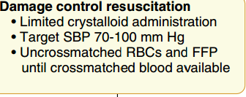

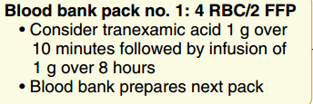

Fig. Example of a massive transfusion protocol
Contact blood bank Stop MTP
Yes
Bleeding controlled?
Subsequent packs: 6 RBC/6 FFP/6 platelets

Slide 56
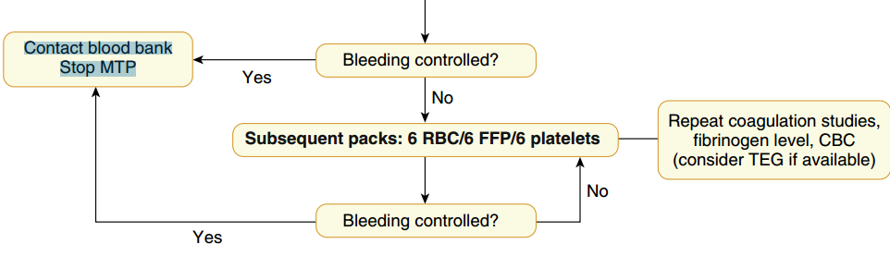
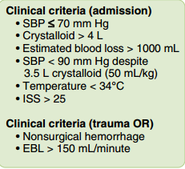
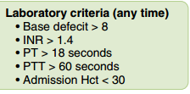
Fig. Example of a massive transfusion protocol using specifed ratios of blood products. CBC, Complete blood count; EBL, estimated blood loss; FFP, fresh frozen plasma; INR, international normalized ratio; ISS, injury severity score; OR, operating room; PT, prothrombin time; PTT, partial thromboplastin time; RBC, red blood cell; SBP, systolic blood pressure; TEG, thromboelastogram

Slide 57
Complications of Massive Transfusion
Massive transfusion can lead to complications from the administration of blood products and significant intravascular volume changes.
Goals of Transfusion:
  Support circulating blood volume.
  Enhance oxygen delivery.
  Improve coagulation function.
  Ensure adequate tissue perfusion and prevent shock-related sequelae.

Slide 58
Cont..
Hypocalcemia:
  Hypocalcemia is a common complication encountered during massive transfusion, often due to citrate used in stored blood products.
  Citrate as an Anticoagulant: Citrate binds to circulating ionized calcium (and magnesium), leading to hypocalcemia
Metabolism of Citrate:
  Normally, citrate is rapidly metabolized by the liver.
  Shock can impair hepatic function, resulting in reduced metabolism and potential citrate toxicity.

Slide 59
Cont..
Manifestations of Citrate Toxicity:
  Myocardial depression.
  Possible progression to apparent acute heart failure.
  Symptoms may include hypotension and narrow pulse pressure.
Monitoring and Management:
  Frequent monitoring of ionized calcium levels is essential during massive transfusion.
  Intravenous calcium supplementation may be necessary to prevent complications.

Slide 60
Cont…
When administering one round of MTP (containing 6 units PRBCs), it's probably reasonable to add either
  1-2 gram of IV calcium chloride or 3-6 grams of IV calcium gluconate.
  Calcium gluconate causes less tissue damage with extravasation, so this is preferred for peripheral administration.

Slide 61
Cont….
Hypothermia
Acid/base derangements
Coagulopathy
Electrolyte abnormalities
  hypomagnesemia
  hypokalemia
  hyperkalemia
Transfusion-associated acute lung injury

Slide 62
Damage Control Surgery
To address intra-abdominal hemorrhage quickly, stabilizing the patient and preventing complications.
Objectives:
  Control Hemorrhage: Stop ongoing bleeding.
  Limit Contamination: Minimize gastrointestinal spillage into the abdominal cavity.
Initial Assessment: Rapid evaluation of injuries and hemodynamic status.

Slide 63
cont
Surgical Interventions:
  Perform necessary interventions to halt bleeding.
  Place temporary measures (e.g., packing, drainage) to control contamination.
Closure: Leave the abdomen open or close with temporary measures for later definitive surgery.
The anesthesia team must speak up when there is a need to pause the surgical procedure to allow resuscitation.

Slide 64
Cont..
A key component of DCS is planned reoperation once the patient is more stable.
At a later time, bowel continuity can be restored or a colostomy can be performed.

Slide 65
Anesthetic Induction & Maintenance
Severely injured, conscious, and oriented trauma patients arriving for emergency surgery should have an abbreviated interview and examination, including emphasis on consent for blood transfusions and advice that intraoperative awareness may occur during emergency surgery.
The operating room should be as warm as practical.
Intravenous fluid warmers and rapid infusion devices should be prepared and ready for use

Slide 66
Cont…
All patients arriving for trauma surgery should be presumed to have:
  Full stomachs with increased risk for aspiration of gastric contents, and
  The presence of a c-collar for cervical spine stabilization may increase intubation difficulty.
Alternative airway devices (eg, fiberoptic bronchoscope, videolaryngoscope) and robust suction equipment must be immediately available and ready for use.

Slide 67
Cont..
Major blood loss and hemodynamic instability
  A challenging decision for the anesthesia provider planning the induction of general anesthesia.
Trauma patients with severe injuries may experience profound hypotension following even modest doses (0.25–0.5 mg/kg intravenously) of propofol.
Etomidate preserves sympathetic tone, which makes it a modestly safer choice than propofol.

Slide 68
Induction agents
Ketamine:
    0.5-1 mg/kg;
    useful for burn and hypovolemic patients;
Propofol:
    1-2 mg/kg in stable patients;
    reduce doses in Hypovolemia
Scopolamine - 0.4 mg amnesic agent for the hemodynamically unstable

Slide 69
Induction agents
Thiopental:
    3-4 mg/kg;
    reduce doses in unstable patients;
    most commonly used in trauma
Etomidate:
    0.1-0.3 mg/kg;
    reduce doses with hypovolemia; ?myoclonus effects

Slide 70
Induction agents
The combination of ketamine and propofol (i.e., “ketofol”) is gaining popularity for induction of trauma anesthesia and as an intravenous infusion to supplement regional anesthesia for repair of traumatic injury.
Notes:
Ketamine and propofol appear to be somewhat synergistic in inducing anesthesia, and the sympathetic stimulation associated with ketamine is thought to counteract the cardiovascular depression associated with propofol

Slide 71
Muscle relaxants
Succinylcholine: 1-2 mg/kg;
      useful in RSI /emergency
      CI (after 24hrs) in:- Burn, SCI and crush injury
Vecuronium: 0.28 mg/kg high dose: for intubation
      Cardiovascular stability
      No histamine release
      onset in 80 secs;
      duration 75-90 min
Rocuronium: 1.2 mg/kg high dose:
      Histamine release
      On set 45-60 secs;
      duration 67 minutes

Slide 72
Analgesics
Opioid analgesics are an important component of trauma anesthesia practice
  Fentanyl: 1- 3 mcg/kg
  Sulfentanyl : 0.1-0.5 ug/kg
  Morphine: 0.05-0.1mg/kg
Regional anesthesia- blocks

Slide 73
Maintenance
O2/air/isoflorane) mixture
Fentanyl = 1-2 mcg/kg/hr
Monitor fluids and administer carefully
Prepare to give blood products if necessary

Slide 74
Emergence
Normal extubation criteria
Remain intubated for:
  Hemodynamically unstable,
  Elderly with rib and long bone fractures,
  Those who have received massive fluid and blood resuscitation,
  Severe burns, and
  Those with coagulopathies

Slide 75
Postoperative pain Management
Long-acting opioids:-
    morphine
    hydromorphone,
    methadone,
    oxycodone,
Epidural infusions
Peripheral nerve block (PNB)
Intercostal blocks

Slide 76
Regional anesthesia
It can be an important adjunct to the total anesthetic management of the trauma patient, especially for its ability to reduce inflammatory triggers from the site of injury
Epidural anesthesia reduce systemic stress from surgery, but it must be used especially carefully in trauma patients
Peripheral nerve blocks will reduce the need for systemic opioids in the postoperative phase and in many instances allow earlier extubation of the trauma patient with painful injuries

Slide 77
Reference
Harold Ellis: Anatomy for Anaesthetists (8th edition). Blackwell Science Ltd, 2004.
Paul G Barash: Handbook of Clinical Anesthesia (8th edition). Lippincott Williams & Wilkins publications, Inc., 2016.
Ronald D. Miller: Millers Anesthesia (9th edition). Churchill Livingstone publication, An 157 Imprint of Elsevier, 2009.158

Slide 78
question?????
Thank you for your attention

